Slide 1
DEPARTMENT OF CSE COURSE NAME – ADAPTIVE Software Engineering COURSE CODE – 22CI2001
Session-12
Topic:
Agile Modeling &
Extreme Programming

Slide 2
AIM OF THE SESSION
To familiarize students with the basic concept agile modeling
To familiarize students with the basic concept Extreme Programming
INSTRUCTIONAL OBJECTIVES
This Session is designed to:
Demonstrate agile modeling Definition - Scott Ambler
Describe What Is Agile Modeling
List out the Principles for Agile Software development
Introduction to Extreme Programming
Describe XP Model
List out XP Practices
Describe the XP Process
LEARNING OUTCOMES
At the end of this session, you should be able to:
Define agile modeling Definition - Scott Ambler
Describe about the Agile Modeling
Summarize Principles for Agile Software development
Define Extreme Programming
Describe the XP Model
Summarize XP Practices
2

Slide 3

SESSION INTRODUCTION
AGENDA
Introduction to agile model
What Is Agile Modeling?
Agility and the cost of change
An agile process
The Principles for Agile Software Development
Introduction to Extreme Programming
XP Model
Extreme Programming Practices
XP Process

Slide 4
SESSION DESCRIPTION
Introduction to agile model
There are many situations in which software engineers must build large, business critical systems. The scope and complexity of such systems must be modeled so that
all constituencies can better understand what needs to be accomplished,
(2) the problem can be partitioned effectively among the people who must solve it, and
(3) quality can be assessed as the system is being engineered and built

Slide 5
Contd..
Over the past 30 years, a wide variety of software engineering modeling methods and notation have been proposed for analysis and design (both architectural and component-level).
These methods have merit, but they have proven to be difficult to apply and challenging to sustain (over many projects).

Slide 6
What Is Agile Modeling?
Agile Modeling (AM) is a practices-based process that describes how to be an effective modeler.
AM helps you find the modeling sweet spot, where you have modeled enough to explore and document your system effectively, but not so much that it becomes a burden that slows the project down.

Slide 7
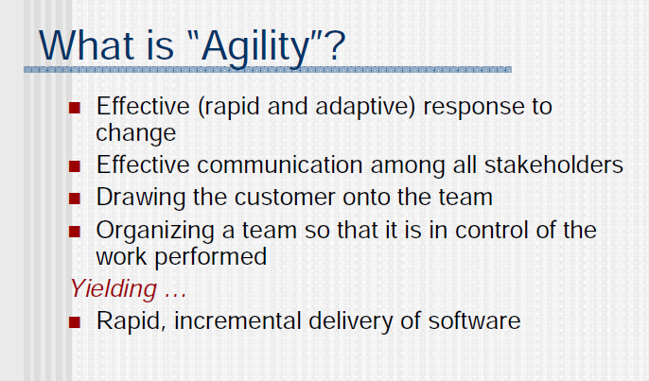
What is agility ?

Slide 8
Scott Ambler describes agile modeling as
At “The Official Agile Modeling Site,” Scott Ambler [Amb02a] describes agile modeling (AM) in the following manner:
“Agile Modeling (AM) is a practice-based methodology for effective modeling and documentation of software-based systems. Simply put, Agile Modeling (AM) is a collection of values, principles, and practices for modeling software that can be applied on a software development project in an effective and light-weight manner. Agile models are more effective than traditional models because they are just barely good, they don’t have to be perfect.”

Slide 9
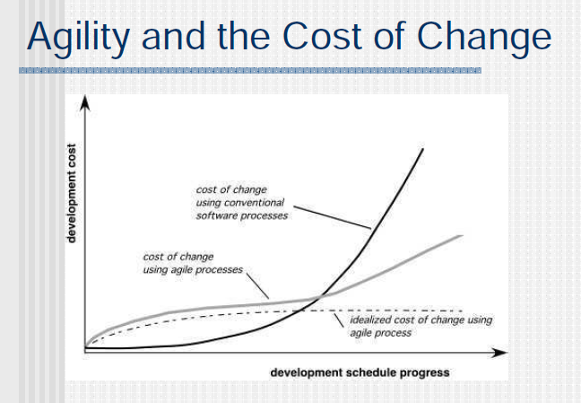
Agility and the cost of change

Slide 10
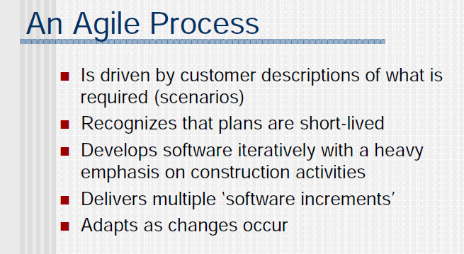
An agile process

Slide 11
The Principles for Agile Software Development
Agile Modeling (AM), should conform to. These principles are:
Our highest priority is to satisfy the customer through early and continuous delivery of valuable software.
2. Welcome changing requirements, even late in development. Agile processes harness change for the customer’s competitive advantage.
3. Deliver working software frequently, from a couple of weeks to a couple of months, with a preference to the shorter time scale.
4. Business people and developers must work together daily throughout the project.
5. Build projects around motivated individuals. Give them the environment and support they need, and trust them to get the job done.
6. The most efficient and effective method of conveying information to and within a development team is face-to-face conversation

Slide 12
Contd..
7. Working software is the primary measure of progress.
8. Agile processes promote sustainable development. The sponsors, developers, and users should be able to maintain a constant pace indefinitely.
9. Continuous attention to technical excellence and good design enhances agility.
10. Simplicity—the art of maximizing the amount of work not done— is essential.
11. The best architectures, requirements, and designs emerge from self-organizing teams.
12. At regular intervals, the team reflects on how to become more effective, and then tunes and adjusts its behavior accordingly.

Slide 13
Contd..
Although AM suggests a wide array of “core” and “supplementary” modeling principles, those that make AM unique are [Amb02a]:
Model with a purpose:
A developer who uses AM should have a specific goal (e.g., to communicate information to the customer or to help better understand some aspect of the software) in mind before creating the model. Once the goal for the model is identified, the type of notation to be used and level of detail required will be more obvious

Slide 14
Contd.
Travel light :
As software engineering work proceeds, keep only those models that will provide long-term value and discard the rest. Every work product that is kept must be maintained as changes occur.

Slide 15
Contd.
Content is more important than representation :
A syntactically perfect model that imparts little useful content is not as valuable as a model with flawed notation that nevertheless provides valuable content for its audience.
Know the models and the tools you use to create them :
Understand the strengths and weaknesses of each model and the tools that are used to create it.
Adapt locally :
The modeling approach should be adapted to the needs of the agile team.

Slide 16
Introduction to Extreme Programming
An agile development methodology XP is “a lightweight methodology for small to medium-sized teams developing software in the face of vague or rapidly changing requirements
It works by bringing the whole team together in the presence of simple practices, with enough feedback to enable the team to see where they are and to tune the practices to their unique situation?

Slide 17
Introduction to Extreme Programming Contd…
Extreme Programming
■ Hence XP is a lightweight (agile) process:
◻Instead of lots of documentation nailing down what customer wants up front, XP emphasizes plenty of feedback
◻Embrace change: iterate often, design and redesign, code and test frequently, keep the customer involved
◻Deliver software to the customer in short (2 week) iterations
◻Eliminate defects early, thus reducing costs

Slide 18
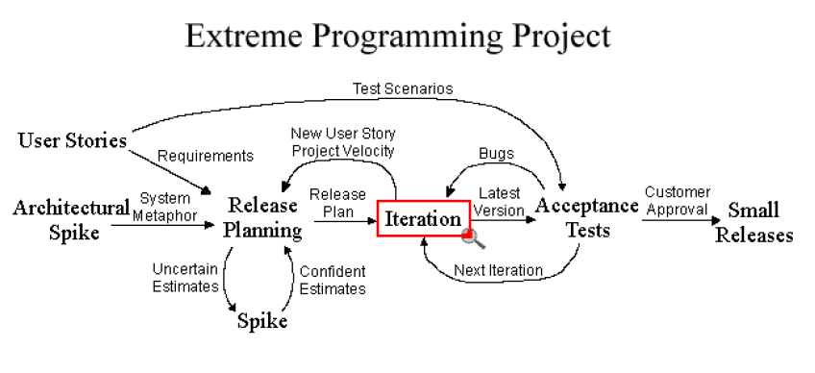
XP MODEL

Slide 19
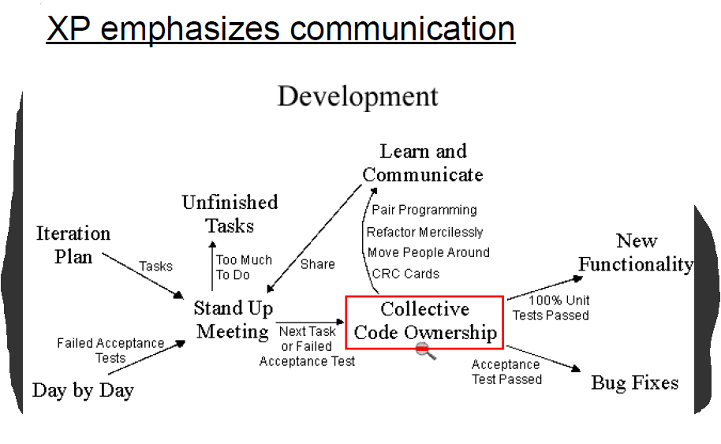
CONTD…

Slide 20
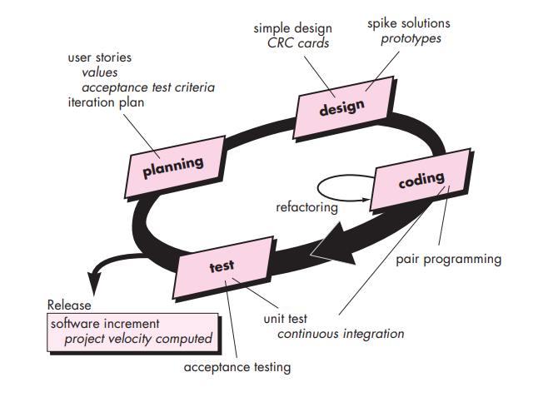
THE XP PROCESS

Slide 21
THE XP PROCESS CONTD…
Extreme Programming uses an object-oriented approach as its preferred development paradigm and encompasses a set of rules and practices that occur within the context of four framework activities: planning, design, coding, and testing

Slide 22
THE XP PROCESS CONTD…
Planning
The planning activity begins with listening—a requirements gathering activity that enables the technical members of the XP team to understand the business context for the software and to get a broad feel for required output and major features and functionality.
Listening leads to the creation of a set of “stories” (also called user stories) that describe required output, features, and functionality for software to be built

Slide 23
THE XP PROCESS CONTD…
Design
XP design rigorously follows the KIS (keep it simple) principle. A simple design is always preferred over a more complex representation.
XP encourages the use of CRC (class-responsibilitycollaborator) cards as an effective mechanism for thinking about the software in an object-oriented context

Slide 24
THE XP PROCESS CONTD…
Coding
After stories are developed and preliminary design work is done, the team does not move to code, but rather develops a series of unit tests that will exercise each of the stories that is to be included in the current release
Once the unit test has been created, the developer is better able to focus on what must be implemented to pass the test
Once the code is complete, it can be unit-tested immediately, thereby providing instantaneous feedback to the developers.

Slide 25
THE XP PROCESS CONTD…
Testing
The unit tests that are created should be implemented using a framework that enables them to be automated (hence, they can be executed easily and repeatedly).
This encourages a regression testing strategy whenever code is modified (which is often, given the XP refactoring philosophy).
XP acceptance tests, also called customer tests, are specified by the customer and focus on overall system features and functionality that are visible and reviewable by the customer

Slide 26
XP Practices :
■ Small Releases
■ Simple Design
■ Testing
■ Refactoring
■ Pair Programming
■ Collective Ownership
■ Continuous Integration
■ On-site Customer

Slide 27
XP Practices CONTD…
Small Releases :
■ Small in terms of functionality
■ Less functionality means releases happen more frequently
■ Support the planning game
Advantages
◻ Frequent feedback
◻ Tracking
◻ Reduce chance of overall project slippage
Disadvantages
◻ Not easy for all projects
◻ Not needed for all projects
◻ Versioning issues

Slide 28
XP Practices CONTD…
Simple Design:
■ Keep it simple
■ Do as little as needed, nothing more
Advantages
◻ Time is not wasted adding superfluous functionality
◻ Easier to understand what is going on
◻ Refactoring and collective ownership is made possible
◻ Helps keeps programmers on track
Disadvantages
◻ What is “simple?”
◻ Simple isn’t always best

Slide 29
XP Practices CONTD…
Testing :
■ Unit testing
■ Test-first design
■ All automated
Advantages
◻ Unit testing promote testing completeness
◻ Test-first gives developers a goal
◻ Automation gives a suite of regression test
Disadvantages
◻ Automated unit testing isn’t for everything
◻ Reliance on unit testing isn’t a good idea
◻ A test result is only as good as the test itself

Slide 30
XP Practices CONTD…
Refactoring :
■ Changing how the system does something but not what is done
■ Improves the quality of the system in some way
Advantages
◻ Prompts developers to proactively improve the product as a whole
◻ Increases developer knowledge of the system
Disadvantages
◻ Not everyone is capable of refactoring
◻ Refactoring may not always be appropriate
◻ Would upfront design eliminate refactoring?

Slide 31
XP Practices CONTD…
Pair Programming:
■ Two Developers, One monitor, One Keyboard
■ One “drives” and the other thinks
■ Switch roles as needed
Advantages
◻ Two heads are better than one
◻ Focus
◻ Two people are more likely to answer the following questions:
■ Is this whole approach going to work?
■ What are some test cases that may not work yet?
■ Is there a way to simplify this?
Disadvantages
◻ Many tasks really don’t require two programmers
◻ A hard sell to the customers

Slide 32
XP Practices CONTD…
Collective Ownership :
■ The idea that all developers own all of the code
■ Enables refactoring
Advantages
◻ Helps mitigate the loss of a team member leaving
◻ Promotes developers to take responsibility for the system as a
whole rather then parts of the system
Disadvantages
◻ Loss of accountability
◻ Limitation to how much of a large system that an individual can
practically “own”

Slide 33
XP Practices CONTD…
Continuous Integration:
■ New features and changes are worked into the system
immediately
■ Code is not worked on without being integrated for more
than a day
Advantages
◻ Reduces to lengthy process
◻ Enables the Small Releases practice
Disadvantages
◻ The one day limit is not always practical
◻ Reduces the importance of a well-thought-out architecture

Slide 34
XP Practices CONTD…
On-Site Customer :
■ Acts to “steer” the project
■ Gives quick and continuous feedback to the development team
Advantages
◻ Can give quick and knowledgeable answers to real development
questions
◻ Makes sure that what is developed is what is needed
◻ Functionality is prioritized correctly
Disadvantages
◻ Difficult to get an On-Site Customer
◻ The On-Site customer that is given may not be fully knowledgeable about what
the company
◻ May not have authority to make many decisions
◻ Loss of work to the customer’s company

Slide 35
SELF-ASSESSMENT QUESTIONS
Define agile modeling.
What are factors responsible agility and the cost of change?
Describe the agile process.
Describe the Principles for Agile Software Development.
Define extreme programming.
List out the extreme programming Practices
What is the need of extreme programming process.
Describe the extreme programming Process

Slide 36
REFERENCES FOR FURTHER LEARNING OF THE SESSION
TEXTBOOKS:
Roger S.Pressman, “Software Engineering – A Practitioner’s Approach” 7th Edition, Mc Graw Hill,(2014).
Ian Sommerville, “Software Engineering”, Tenth Edition, Pearson Education, (2015).
Reference Book
Agile and Iterative Development: A Manager's Guide, Craig Larman, Addison-Wesley
WEB REFERNCES/MOOCS:
https://www.digite.com/kanban/what-is-kanban/
http://www.scaledagileframework.com
https://www.guru99.com/test-driven-development.html
https://junit.org/junit5/

Slide 37
THANK YOU
Team – Adaptive Software Engineering

